Slide 1
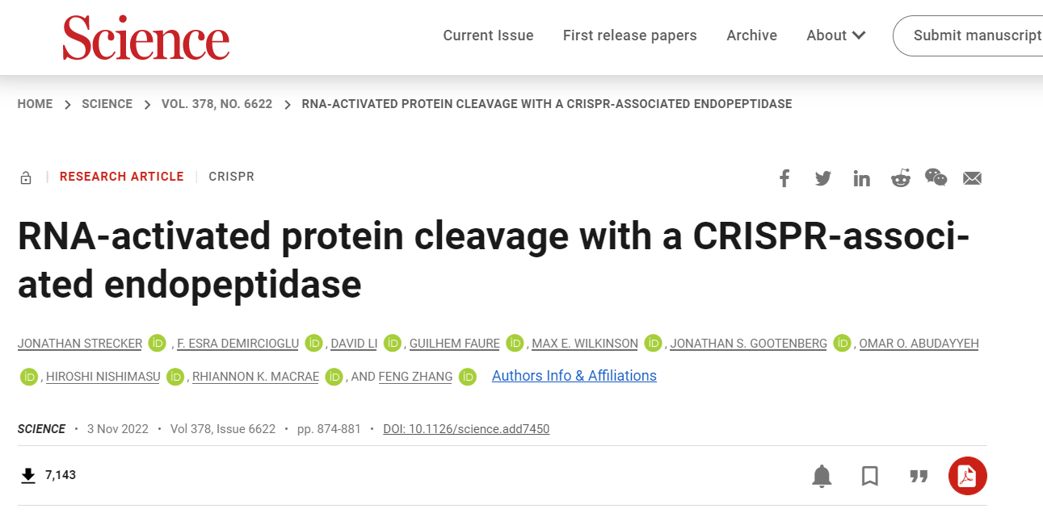

Slide 2
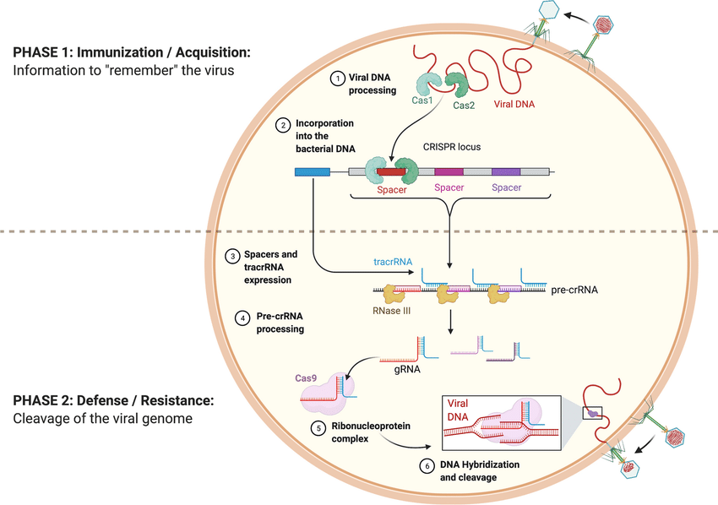
CRISPR-Cas systems that mediate adaptive immunity in bacteria and archaea
Are there other targets of the CRISPR systems?
What are the previously undetected, putative CRISPR-accessory proteins?
Ghorbani (2021). Transgenic Research

Slide 3
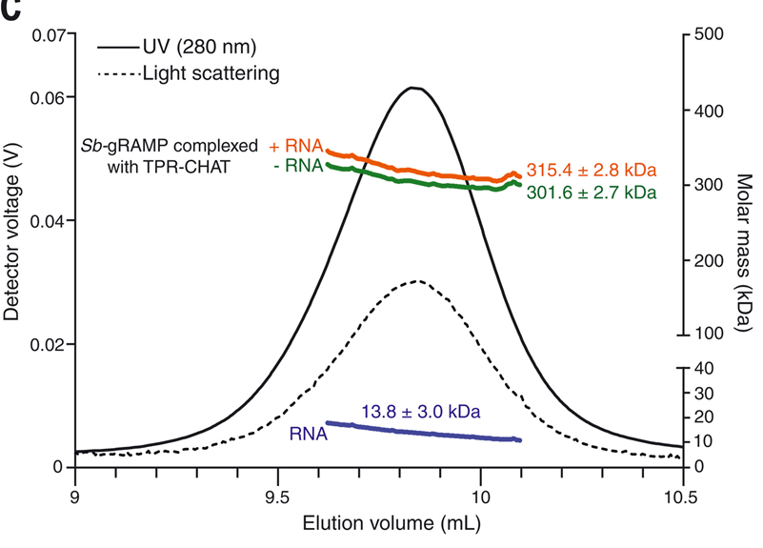
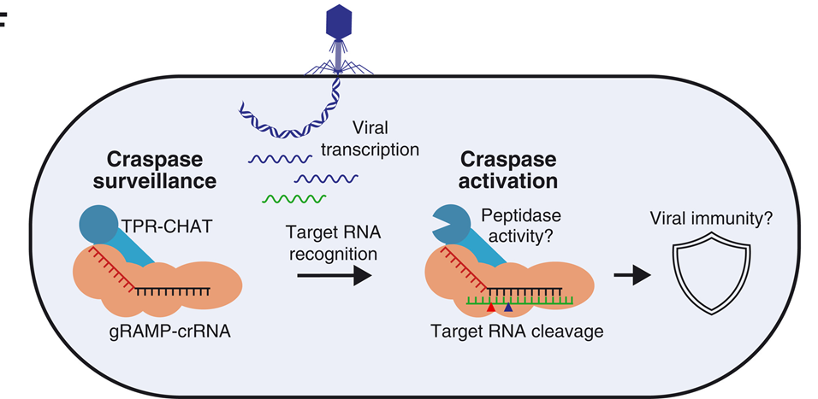
Previous research indicates that crRNA forms complex with enzymes besides endonuclease:
The gRAMP type III-E CRISPR-Cas effector is an RNA endonuclease complexed with a caspase-like peptidase
Suggesting a potential mechanism of target RNA–induced protease activity to gain viral immunity,
but did not characterize the peptidase activity
Van BELJOUW et al Science 2021

Slide 4
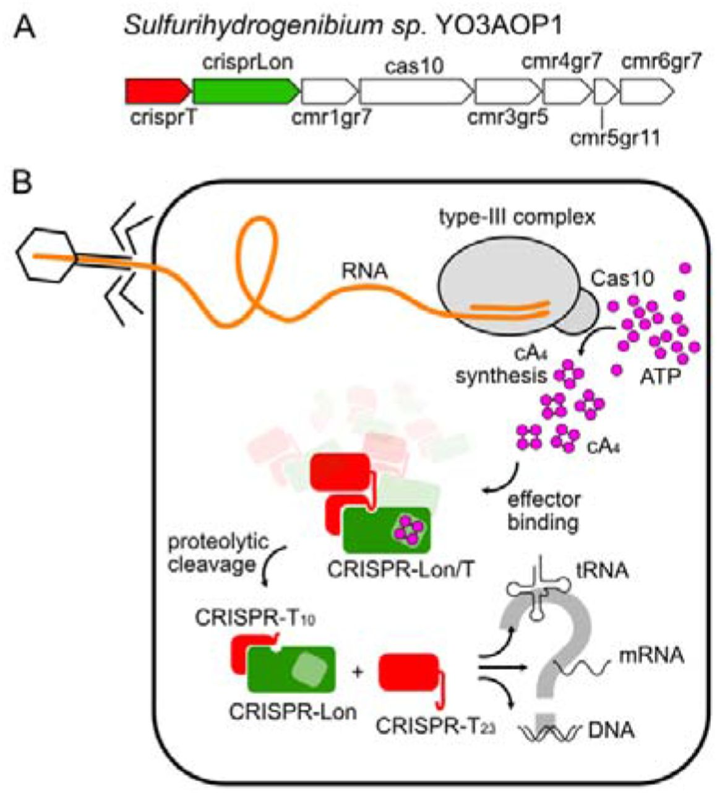
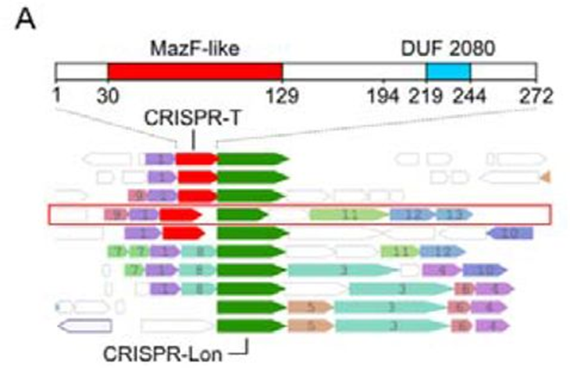
CRISPR-Lon protease at the type III-B CRISPR-Cas loci was shown to specifically cleaves CRISRP-T upon foreign RNA recognition
Release of CRISPR-T23 domain fragment predicted to have a MazF-like 26, 27 RNAse activity
Beyond CAST systems, are there additional effectors genetically linked to CRISPR?
Rouillon et al BioRxiv Dec 2021

Slide 5
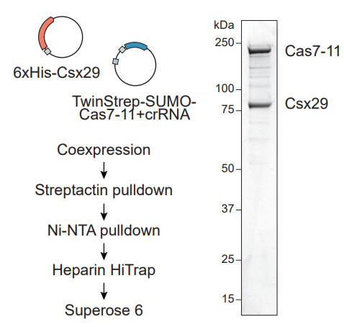
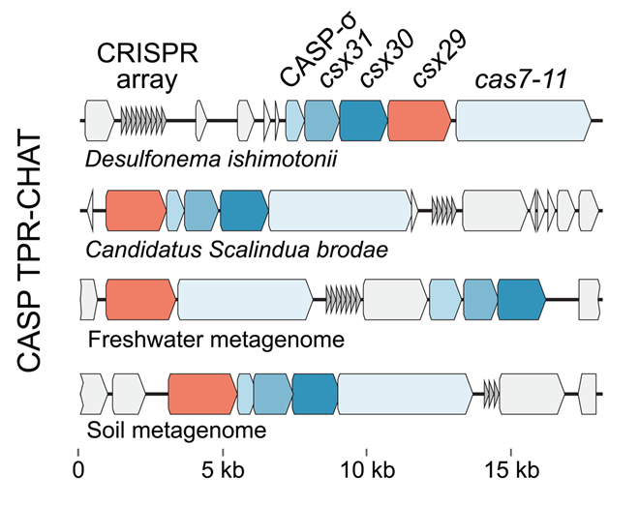
Deep look of the type III-E loci: what are the genes/proteins co-occurring with CRISPR-Cas and do they involve in CRISPR-Cas functions?
In addition to the associated Csx29 protease, type III-E loci frequently contain three additional genes: csx30, csx31, CASP-σ
Purification and SDS-PAGE analysis of a Cas7-11-Csx29 complex
Does the Cas7-11-Csx29 complex cleave proteins coded by upstream genes in the presence of a target RNA complementary to the crRNA?

Slide 6
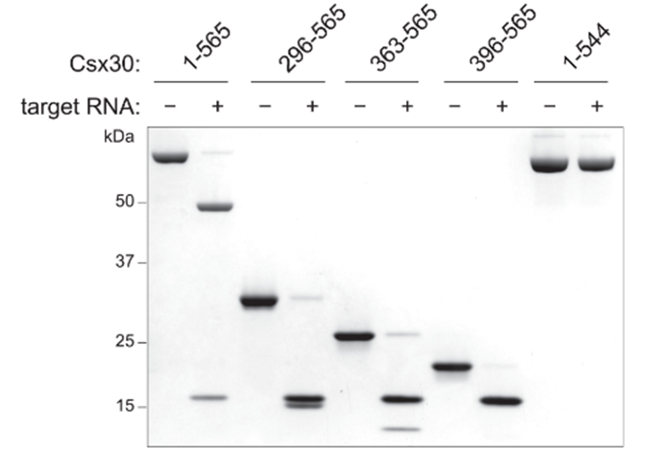
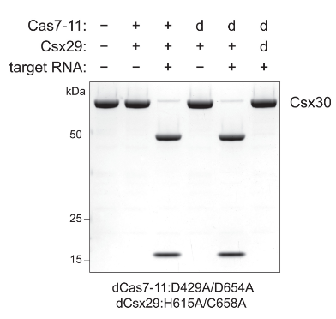
The type III-E Csx29 cleaves Csx30 in response to target RNA
Cell free reaction of Cas7-11-Csx29 complex, Csx30, target RNA
dCas7-11: mutate catalytic site D429 D654
dCsx29: mutated catalytic site H615 C658
Full length Csx30: 565AA
Csx30 C-terminal residues are strictly required
Does cleavage activity required full complementarity between the crRNA and target RNA?

Slide 7
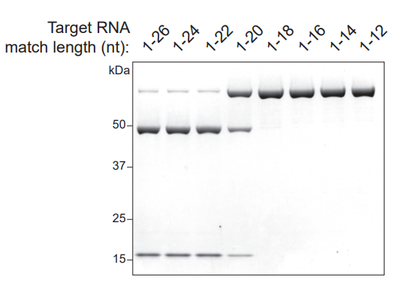
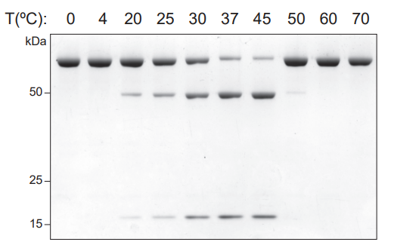
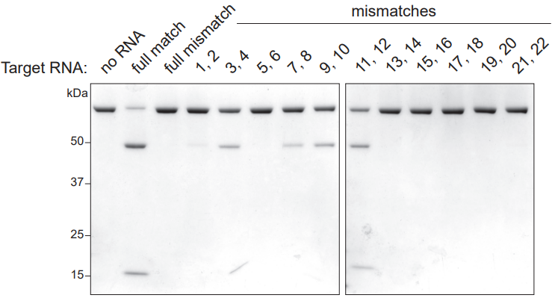
The type III-E Csx29 cleaves Csx30 in response to target RNA
Optimal activity between 37° and 45°C
Low tolerance to base-pair mismatches, particularly at the 5′ end of the target RNA
Csx30
At which position does Csx30 get cleaved?

Slide 8
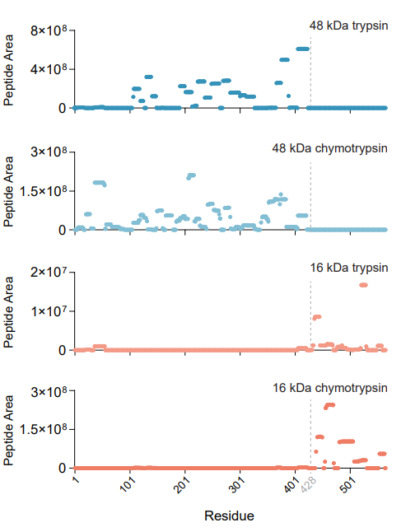
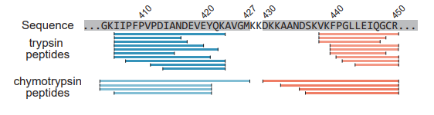
Csx30 is cleaved between residues 427 and 429
How does the complex look?

Slide 9
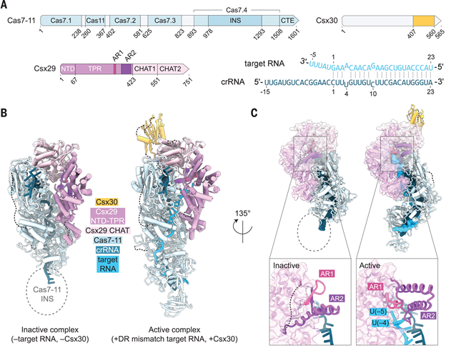
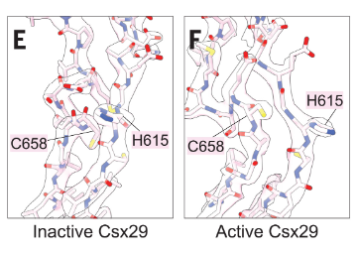
Allosteric activation of Csx29 upon RNA binding
Csx29 consists of a three-helix bundle NTD, a TPR domain with eight repeats, and a protease region containing a pseudo-caspase (CHAT1) and active-caspase (CHAT2) domain
C658 and H615 repositioned
Exposure of catalytic site
What is the outcome of the cleavage?

Slide 10
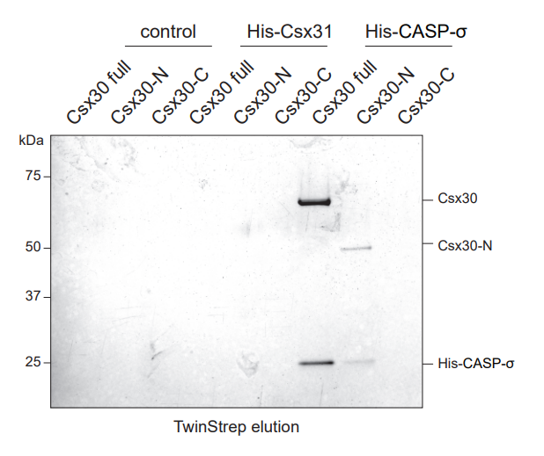
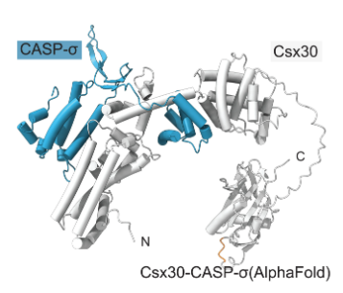
Csx30 binds CASP-σ
After several try and error:
Csx30 does not promote cell death, does not prevent phage propagation
Homology searches revealed a match of Csx30-C to a peptidoglycan N-acetylglucosamine deacetylase, but we did not detect modification of peptidoglycan
Overexpression of Csx30 fragments was not toxic in Escherichia coli
Maybe it has something to do with other proteins encoded in the locus? The CASP-σ?
AlphaFold2 prediction of a Csx30-CASP-σ interaction
What does CASP-σ do in the bacteria?

Slide 11
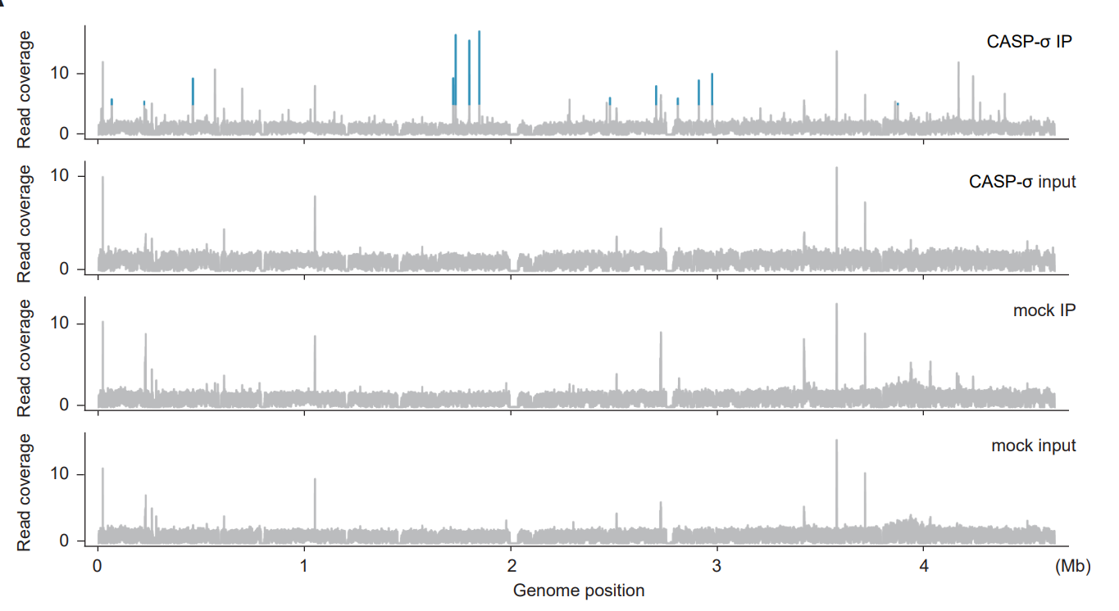
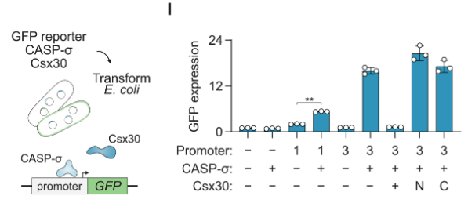
CASP-σ is a transcription factor
Csx30 processing regulates CASP-σ transcriptional activity
CASP-σ strongly resembles an extracytoplasmic function (ECF) sigma factor, a transcription-initiation proteins
Full-length Csx30 completely inhibits CASP-σ–mediated GFP expression
We performed ChIP-seq in E. coli with hemagglutinin (HA)–tagged CASP-σ and identified 13 high-confidence peaks compared with input and mock immunoprecipitation (IP) controls
Model of this CRISPR system? Application on live mammalian cells?

Slide 12
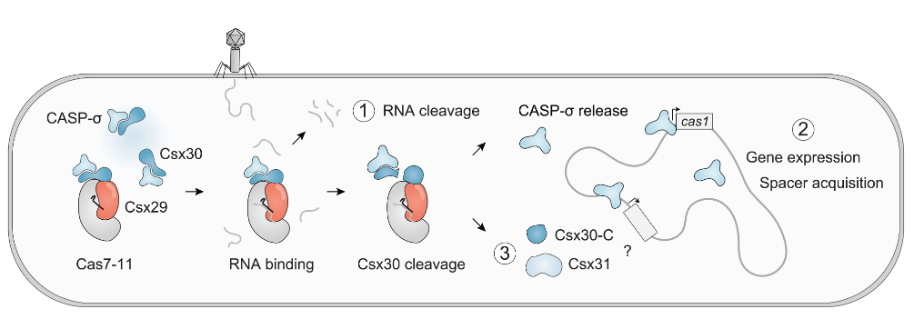
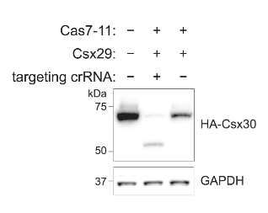
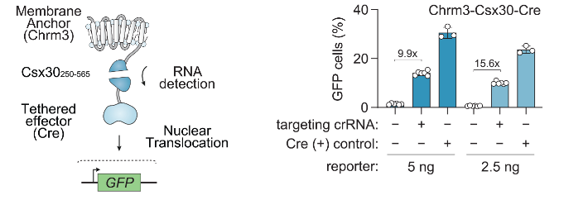
Model for a three-pronged strategy of CASP systems in the defense against foreign genetic elements
Convert RNA sensing with DiCASP into a discrete and readily detectable signal
Proteins and RNA are transfected into HEK293t and were successfully processed
“we sought to design reporters containing effector domains that could be activated by Csx30 cleavage”(Mouse Neuro-2A cells )

